Slide 1
Explainable AI in Medical Diagnosis
Submitted in the partial fulfillment for the award of the degree of
BACHELOR OF ENGINEERING
IN
Artificial Intelligence and Machine Learning
Submitted by:
Aryan Sharma 21BCS5820
Sonika Devi 21BCS8269
Under the Supervision of:
Dr. Monica Luthra
Department of AIT-CSE
DISCOVER . LEARN . EMPOWER

Slide 2
Agenda
Introduction
Problem Formulation
Objectives
Existing Solution
Proposed Solution
Future in SDGs
Methodology
Novelty
Prototype Application

Slide 3
Introduction
Many AI models used in medicine are complex and difficult to understand, hindering trust and adoption.
Explainable AI (XAI) makes AI models understandable, increasing trust, aiding clinical decision-making, and ensuring regulatory compliance.
XAI can help doctors validate or challenge AI-generated diagnoses, leading to improved accuracy and patient outcomes.
Understanding the reasoning behind a diagnosis increases patient confidence and engagement in their healthcare.
XAI can help identify biases in AI models, ensuring fair and equitable healthcare for all patients.

Slide 4
Problem Formulation
Lack of transparency in AI Models : Traditional AI models in medical diagnosis operate as “black boxes,” providing no clear understanding of how they arrive at a decision, which makes it difficult for healthcare professionals to trust and rely on them.
Need for Trust and Accountability : We are using EHR and EMR database to make it more secure and trust will be built
Interpretability for Clinicians : AI models must provide explanations that are easily understood by healthcare providers.
Ethical and Regulatory Compliance : Explainable AI is necessary to meet ethical and regulatory requirements, such as GDPR, ensuring that AI systems in healthcare maintain data privacy and responsible decision-making.

Slide 5
Objectives
Determine the current progress within the different infection/diseases based on AI algorithms and their respective configurations.
To make it to the rural areas because of lack of facilities there.
Discuss the future of medical XAI, supported by explanation measures by human-in-the-loop process in the XAI based systems with case studies.
Demonstrate a novel XAI Recommendation System and XAI Scoring System applicable to multiple fields.

Slide 6
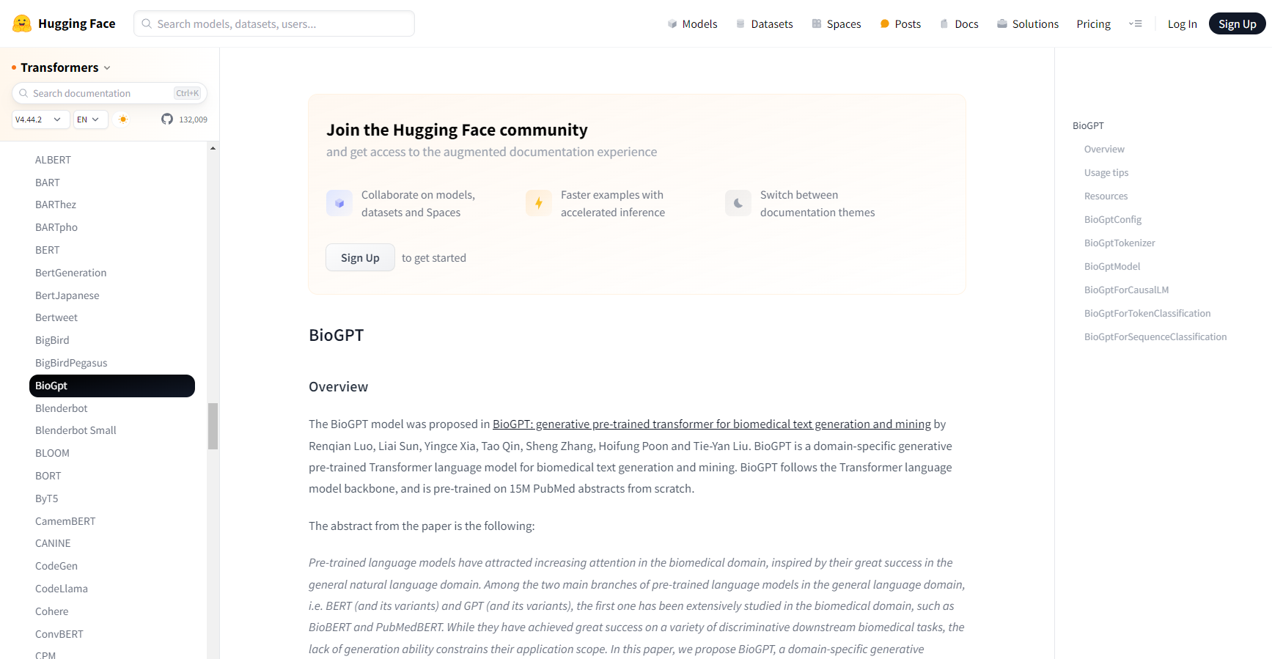
Existing Solution
BioGPT is a language model designed for processing and understanding biomedical literature, enabling tasks like text generation, information extraction, and knowledge discovery in the biomedical domain. It helps researchers and practitioners quickly gather insights from vast amounts of medical and biological texts.

Slide 7


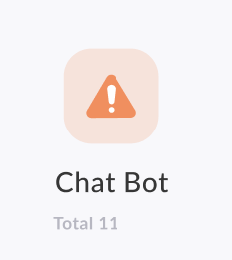
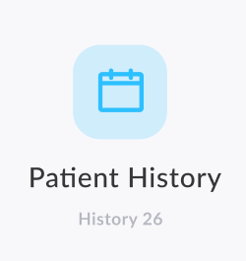
Proposed Solution
SCAN
UPLOAD
CHATBOT
HISTORY

Slide 8

Future in SDG
SDG 3: Good Health and Well-being
SDG 4: Quality Education
SDG 9: Industry, Innovation, and Infrastructure
SDG 10: Reduced Inequalities
SDG 16: Peace, Justice, and Strong Institutions

Slide 9
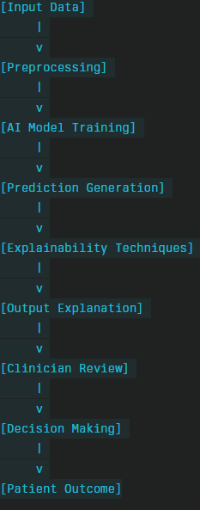
Methodology
Input data : Patient Data
Preprocessing: Data cleaning, Data Normalization and Feature Extraction
AI model training: Model Selection and training
Prediction Generation: Generate Diagnosis
Explainability techniques: Grad-CAM, LIME, or SHAP for interpretability.
Generate heatmaps for feature importance scores.
Output Explanation: Visual and Textual
Clinical review: UI/UX
Decision Making: Doctor’s feedback
Patient outcome: Complete explanation of diagnosis and treatment for the same

Slide 10
Novelty
Concept based explanation: Instead of just highlighting important features, these methods explain diagnoses in terms of high-level medical concepts that doctors are familiar with.
Multimodal explanations: Combining different types of medical data (e.g., imaging, lab results, and patient history) to provide more comprehensive explanations that mirror the way doctors think about diagnoses.
Causal AI: Emerging causal inference techniques aim to move beyond correlation to explain potential cause-and-effect relationships in diagnoses, which is crucial for medical understanding.
Counterfactual explanations with actionable insights: Advanced counterfactual methods that not only show how different inputs would change the diagnosis but also suggest potential treatments or interventions.

Slide 11
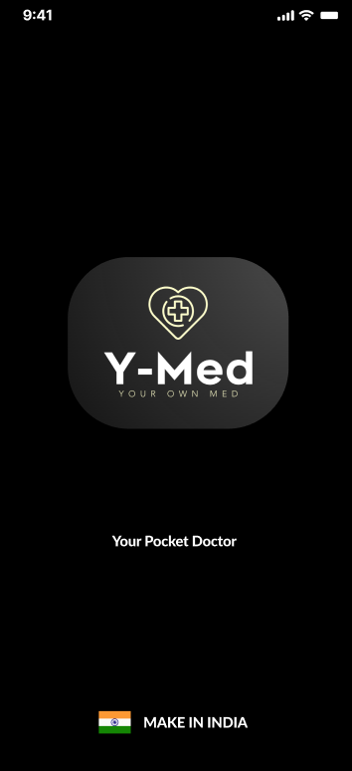
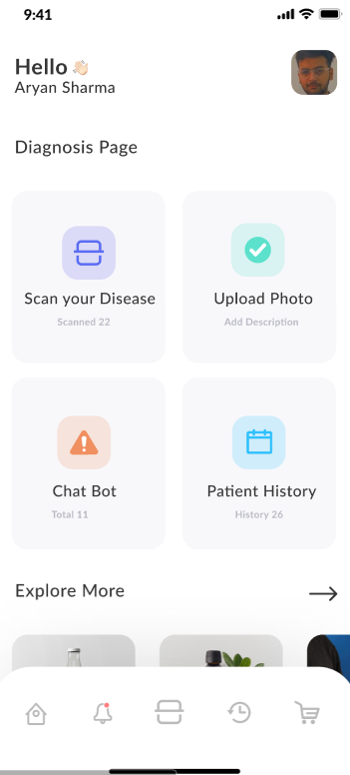
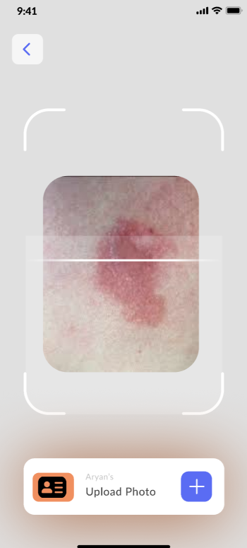
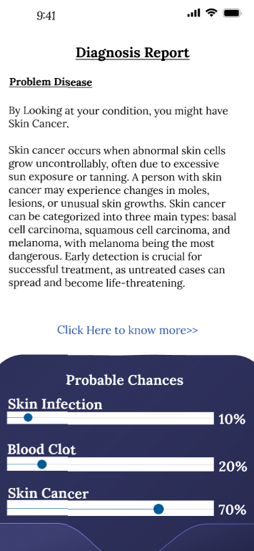
Prototype Application

Slide 12
Thank You!
Q & A

